Slide 1

CS302 Design and Analysis of Algorithms
Muhammad sohail afzal

Slide 2
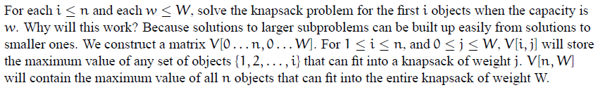
0/1 knapsack problem : Dynamic programming approach

Slide 3
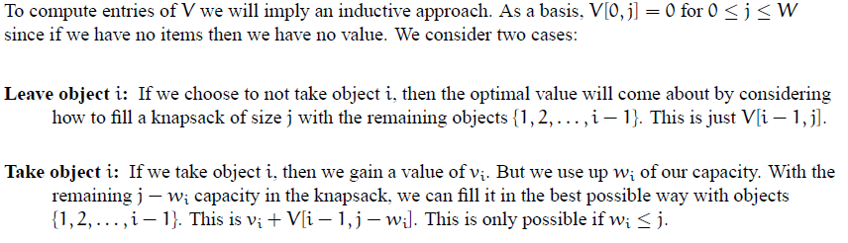

0/1 knapsack problem : Dynamic programming approach

Slide 4
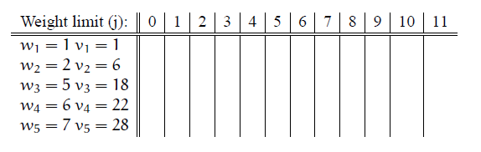
0/1 knapsack problem : Dynamic programming approach
Please note that in class, we created zero row as well. And first of all we filled first row and column with zeros. You can do that too.

Slide 5
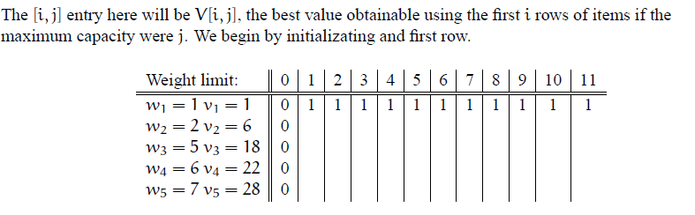
0/1 knapsack problem : Dynamic programming approach

Slide 6
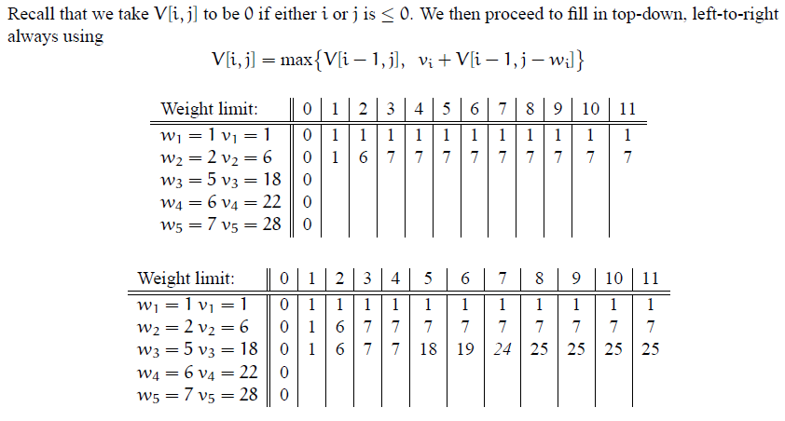
0/1 knapsack problem : Dynamic programming approach

Slide 7
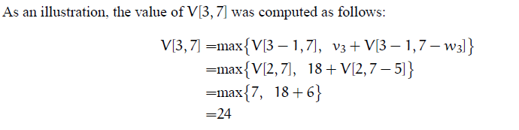
0/1 knapsack problem : Dynamic programming approach

Slide 8
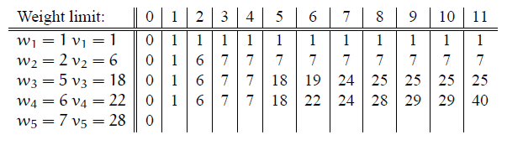
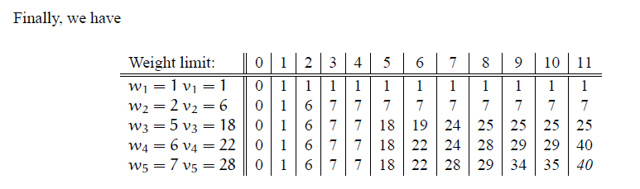
0/1 knapsack problem : Dynamic programming approach

Slide 9
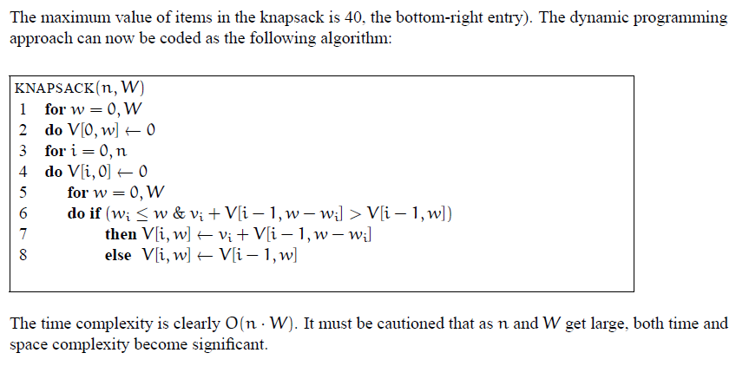
0/1 knapsack problem : Dynamic programming approach

Slide 10
0/1 knapsack problem : Dynamic programming approach
Video Link :
https://www.youtube.com/watch?v=PfkBS9qIMRE&t=654s

